Slide 1

Smart system design course project
LANDMINE DETECTOR
GROUP N.O- 14
Vanamala Kedhareshwar rao Roll n.o 2005A41149
Akula Akshitha Roll n.o 2003A51157
Gaddam Prudhvi Raj Roll n.o 2005A42015

Slide 2
LANDMINE AND IED DETECTION
One person is killed by a landmine every 15 minutes. 26,000 people a year become landmine victims.
5,554 mine casualties took place in 2019. 80% of them are civilians – children representing 43% of the civilian casualties. Still 61 countries and areas around the world are contaminated by landmines and thousands of people continue living with a this daily threat of losing their life or limb.
Risk is higher for military or defusing squad personnel during terrorist activities that are administered by landmines. So, we should increase using of remotely guided machines which detects the landmines and conveys the location of mine to us which prevents Human loss

Slide 3
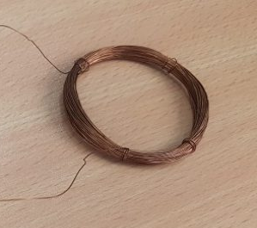
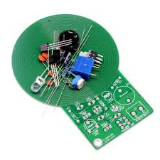
We can make a landmine detector using Arduino ,copper coil, buzzer. Here really we are making a sensor that identifies the metal which is near to it. Or we can use ready made sensons available in the market.
When the device gets close to the metal it detects the metal close to it because of the electromagnetic waves are transmitted from the copper loop.
With these electromagnetic waves, the circuit gives signal to the Arduino. Arduino detects that it is a metal or not and sends the guidance to the signal and the LED by the code. Then Arduino also sends the information about address of landmine by sharing location from GPS helping to point and diffuse landmine easily.
The machine also needs to detect the obstacles and move away from it to Overcome the problem of stucking up . When a landmine is detected it turns on the buzzer so that we can spot the location of the machine and landmine.

Slide 4
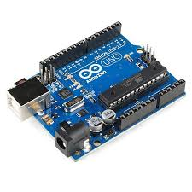
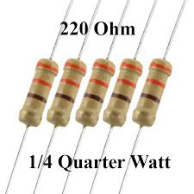
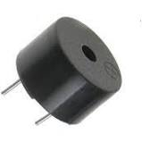
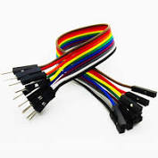
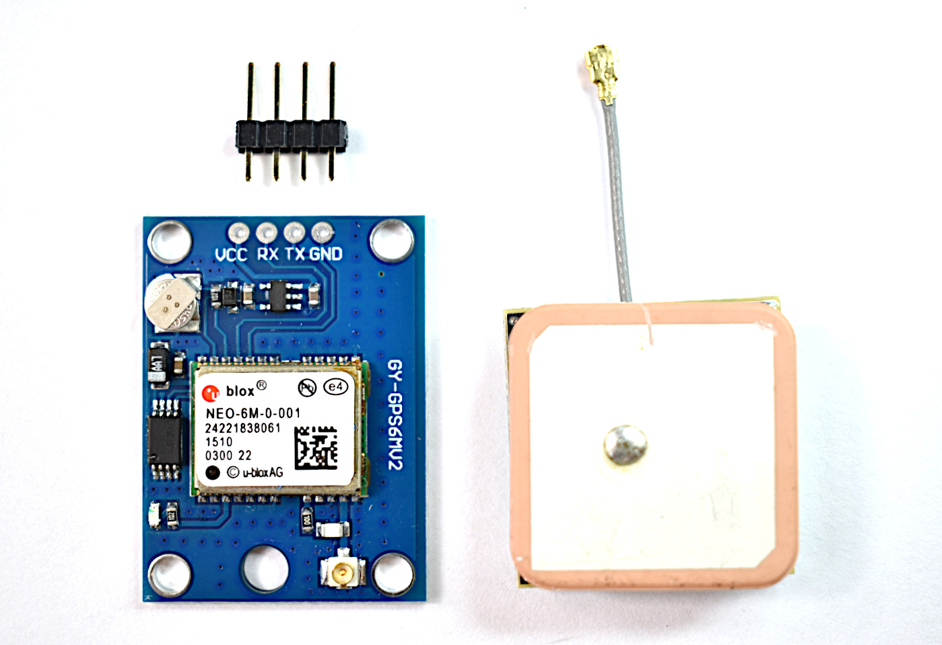
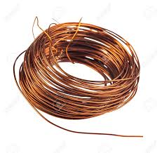

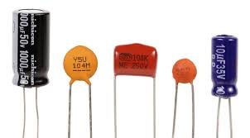
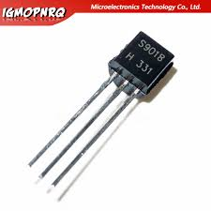
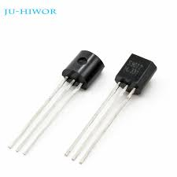
REQUIRED COMPONENTS :
1)Arduino uno
2) 100nF capacitor
3) 2 220Ohm resistors
4) Buzzer
5) ~5 meters of thin copper wire(or ready made sensor)
6) NEO-6M GPS Chip
(2.5m Horizontal position accuracy)
7) Remote control car
11) 9V Volt Battery
12)Antenna
13) 1N 414 Diode
14)104mf capacitors(2)
15)Jumper Wires
16)222 ceramic capacitors(2)
17)9012,9018 transistors

Slide 6
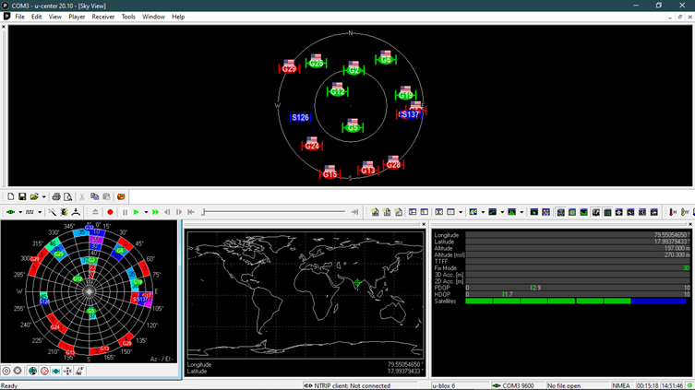
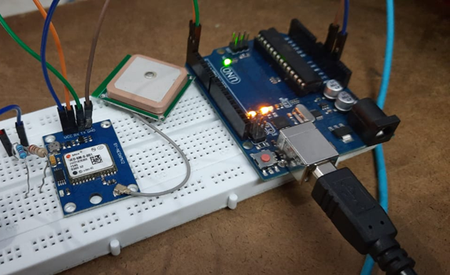
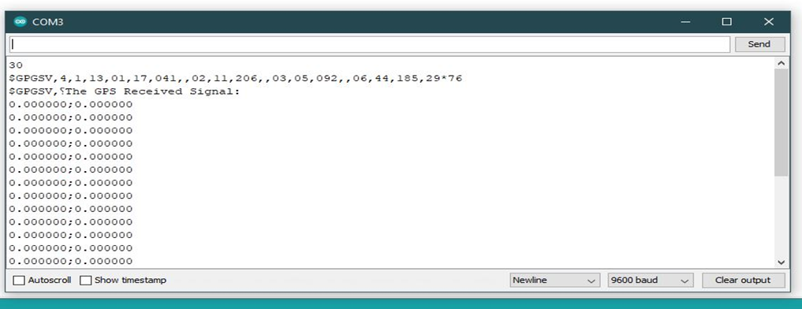
Testing NEO-6M MODULE
OUTPUT THROUGH CONSOLE APPLICATION
OUTPUT IN ARDUINO SERIAL MONITOR

Slide 7
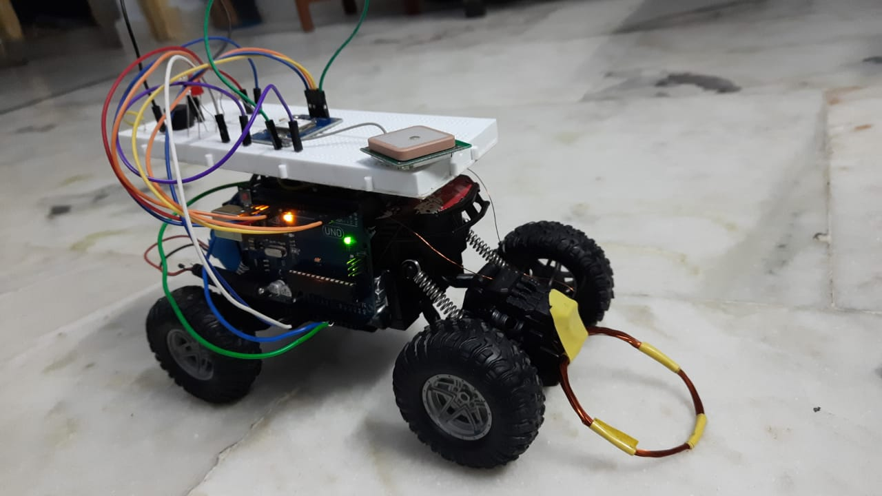
Working Prototype

Slide 8
Thank you

